Slide 1
Profitable Growth Analytics
Notes:
[click for next slide]

Slide 2
Vision & Mission
Profitable Growth Analytics
Vision:
Create a centralized, integrated, and harmonized platform accessing key components from the ISO data solutions that support growing profitably.
Mission:
New Profitable Growth Analytics solution will focus on workflow and allow insurers to seamlessly:
Pinpoint growth opportunities with ISO MarketStance solutions;
Evaluate historical profitability and benchmark current performance through DataCube and Market Landscape;
Monitor recent rate changes via MarketWatch; and
Analyze the portfolio impact of loss cost and rule changes with Portfolio Outcome Visualizer

Slide 3
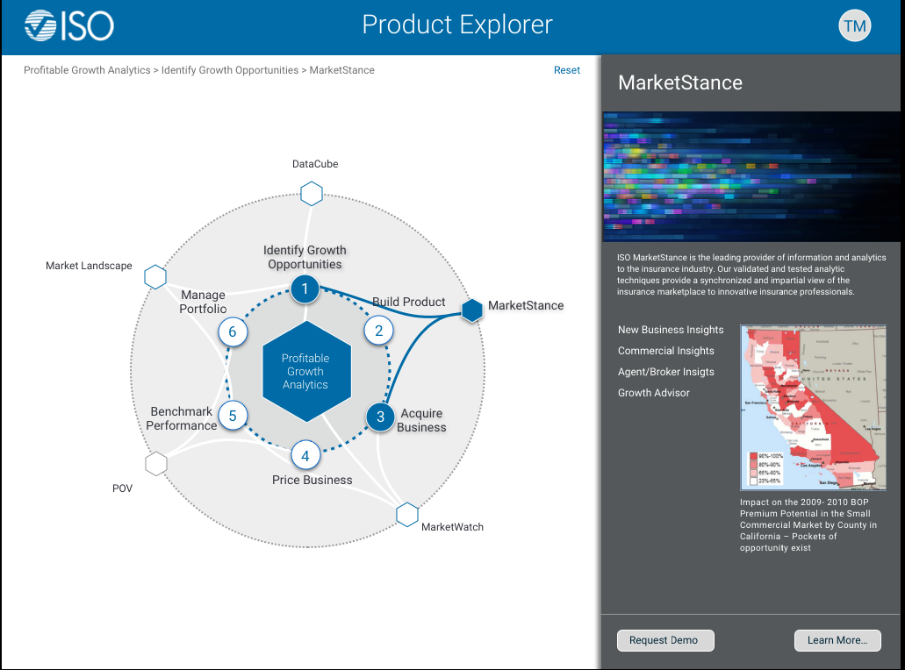
PGA Dashboard – Phase 1 MVP Prototype Link - https://projects.invisionapp.com/share/3GFDA3BET2B#/screens/275751432
Profitable Growth Analytics

